Slide 1


Herwin Abedes
IBM Applied Data Science Capstone 2023

Slide 2

Outline
Executive Summary
Introduction
Methodology
Results
Conclusion
Appendix

Slide 3
Executive Summary
Summary of methodologies
This Project follows the following steps:
Data Collection
Data Wrangling
Exploratory Data Analysis (EDA)
Interactive Visual Analytics
Predictive (Classification) Analysis
Summary of all results
This Project will return the following results:
Data Collection/Wrangling from a selected Website
Interactive Geospatial Analytics
Interactive Dashboard for Success/ Failure Rocket Launches
Predictive Analysis for Classification Problem

Slide 4
Introduction
Project background and context
SpaceX launches Falcon 9 rockets at a cost of around $62m. This is considerably cheaper than other providers (which usually cost upwards of $165m), and much of the savings are because SpaceX can land, and then re-use the first stage of the rocket.
Problems you want to find answers
If we can determine if the first stage will land, we can identify the cost of a launch.
This Project is the result of practicing the SpaceX Data using IBM workflow for Data Science.
Each outputs has its own method and display each objectives on their respective pages or slides.
Short summary for each problems:
Webscraping:
Data Exploration:
Data Visualization
Make Predictions and Get the right fit Model

Slide 5

Section 1

Slide 6
Methodology Summary
Data Collection
Data Wrangling
Exploratory Data Analysis
Interactive Visual Analytics
Data Modelling and Evaluation

Slide 7
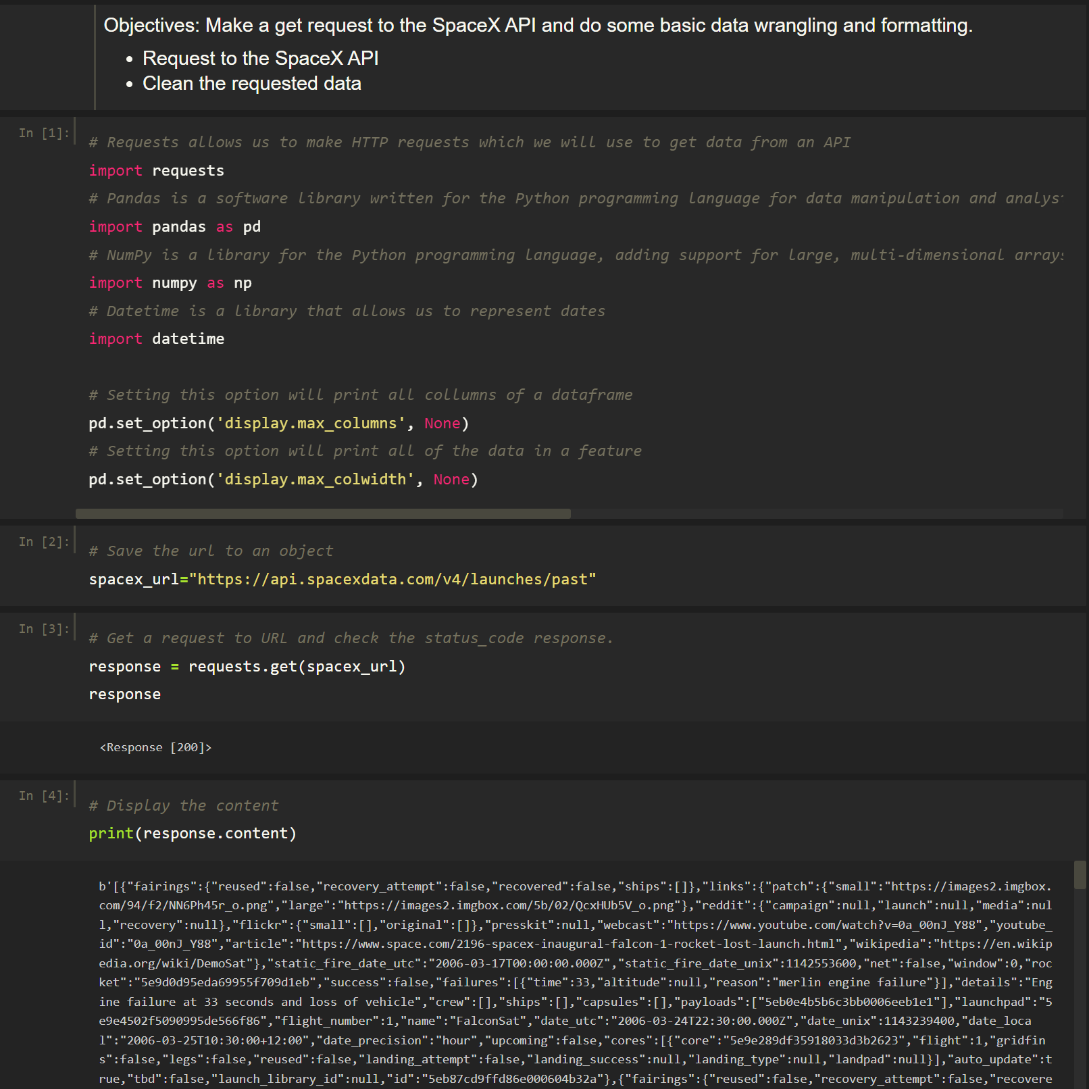
Data Collection – SpaceX API
Present your data collection with SpaceX REST calls using key phrases and flowcharts
1. Import requests and other libraries
2. Save the URL to an object
3. Make a get request to the URL
4. Print the content from the get request
Add the GitHub URL of the completed SpaceX API calls notebook (must include completed code cell and outcome cell), as an external reference and peer-review purpose
Place your flowchart of SpaceX API calls here
Link: SpaceX Data Collection API

Slide 8
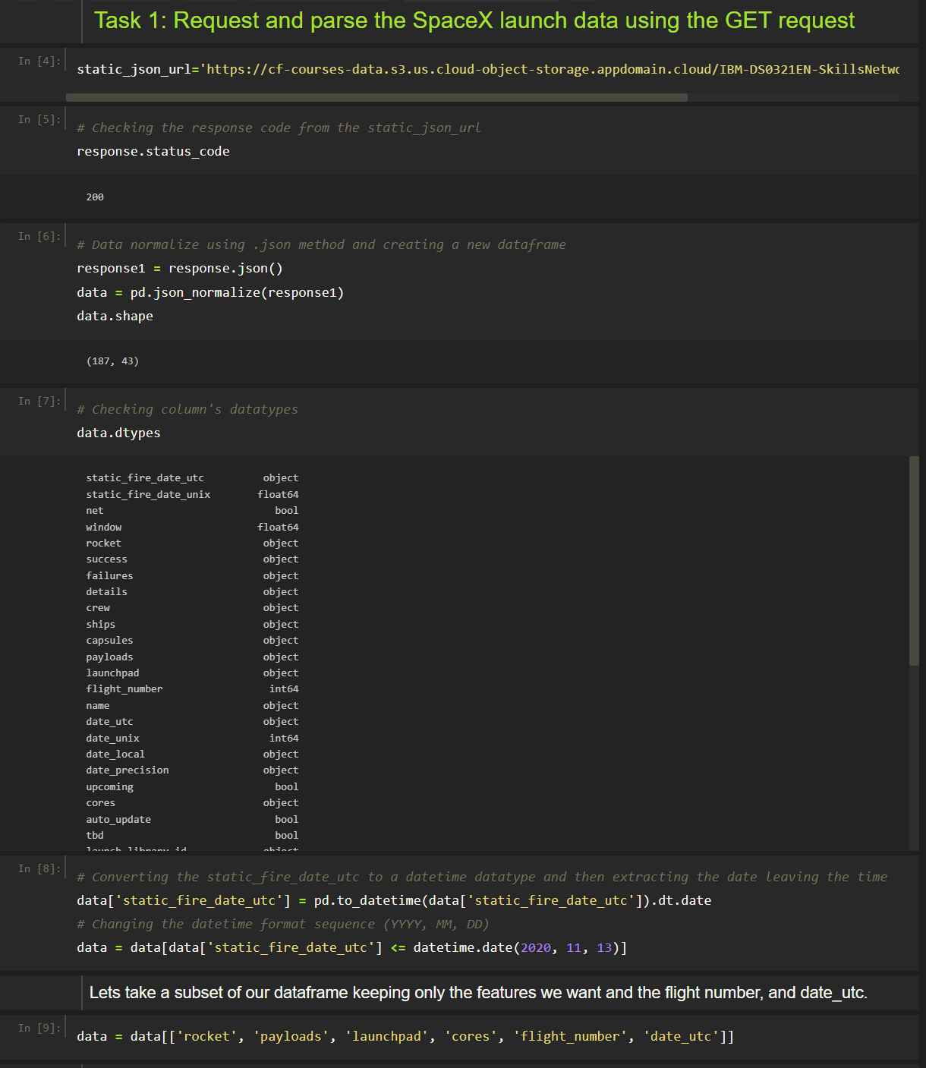
Data Collection – Scraping -1
Present your web scraping process using key phrases and flowcharts
Place your flowchart of web scraping here
1. Import requests library
2. Insert URL
3. Get request
4. Normalize data using .json()
5. Check and align datatypes
6. Filter or remove data that are not needed
7. Create a function that will pick the data values needed and save to a list object
8. Create a dictionary from the list
9. Create a dataframe from dictionary
10. Preview the dataframe
Link: SpaceX Data Collection API

Slide 9
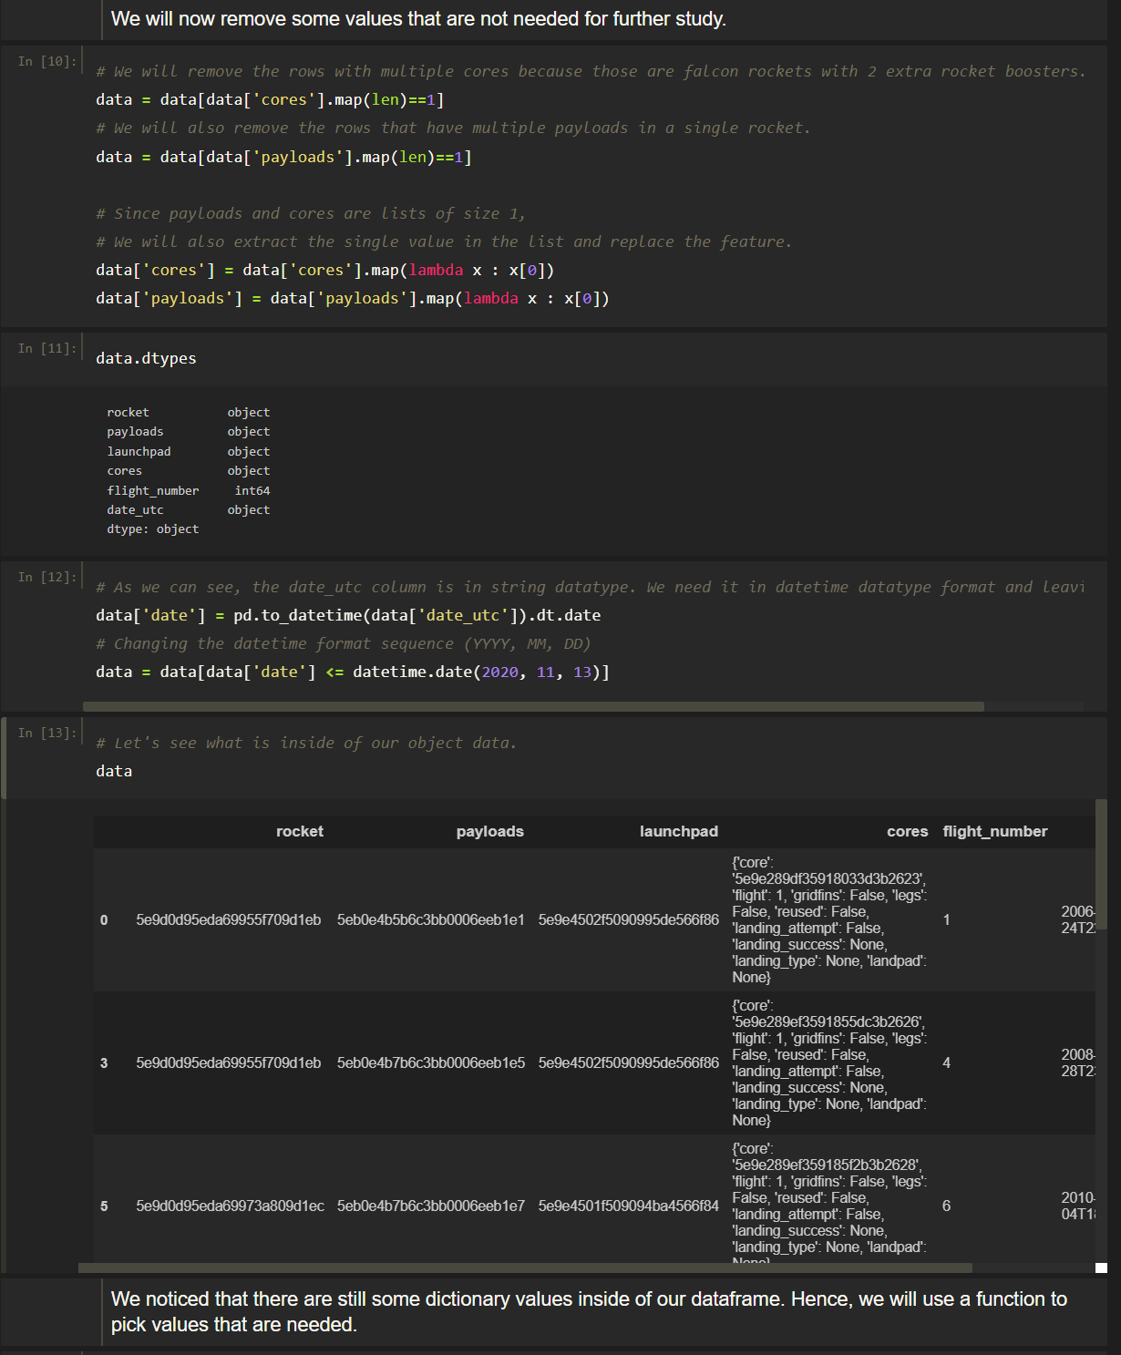
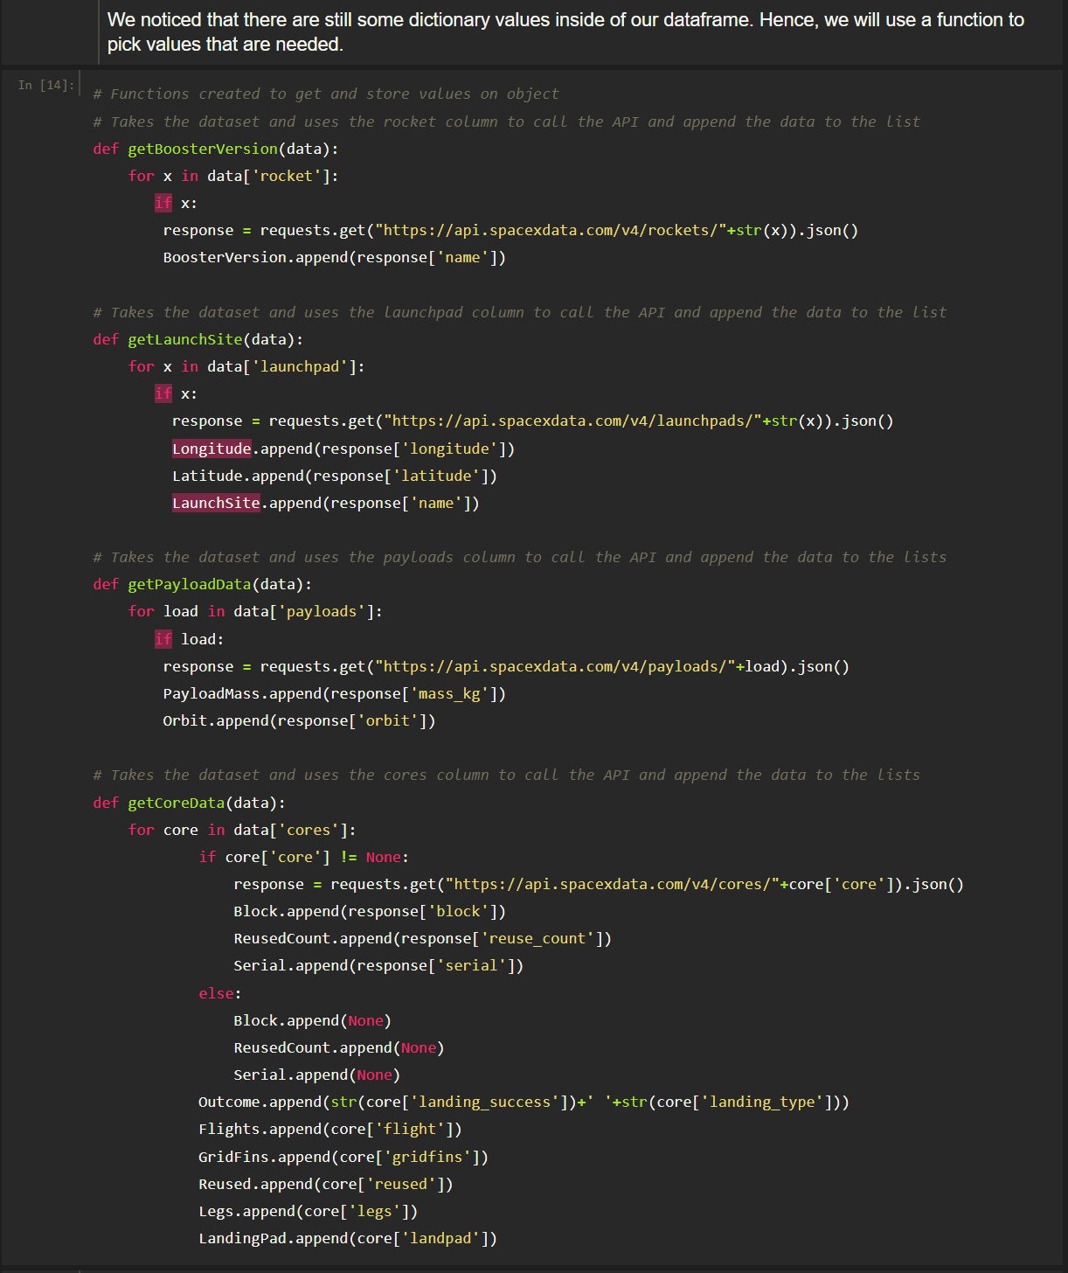
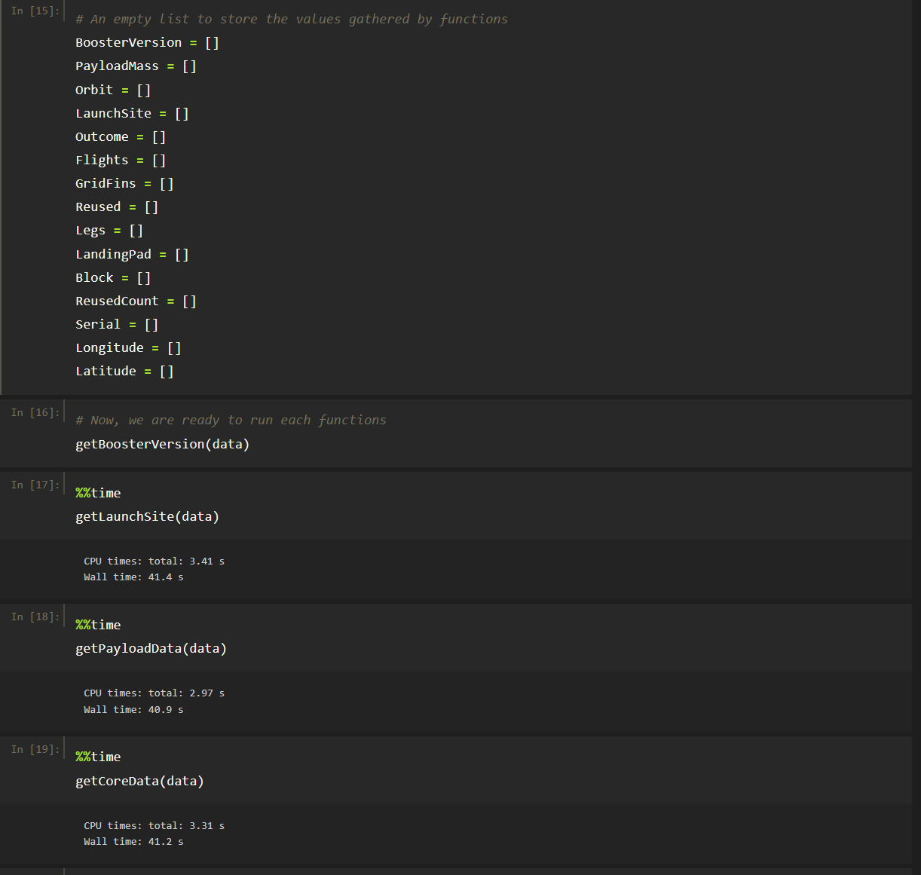
Data Collection – Scraping-2
6
7
Link: SpaceX Data Collection API

Slide 10
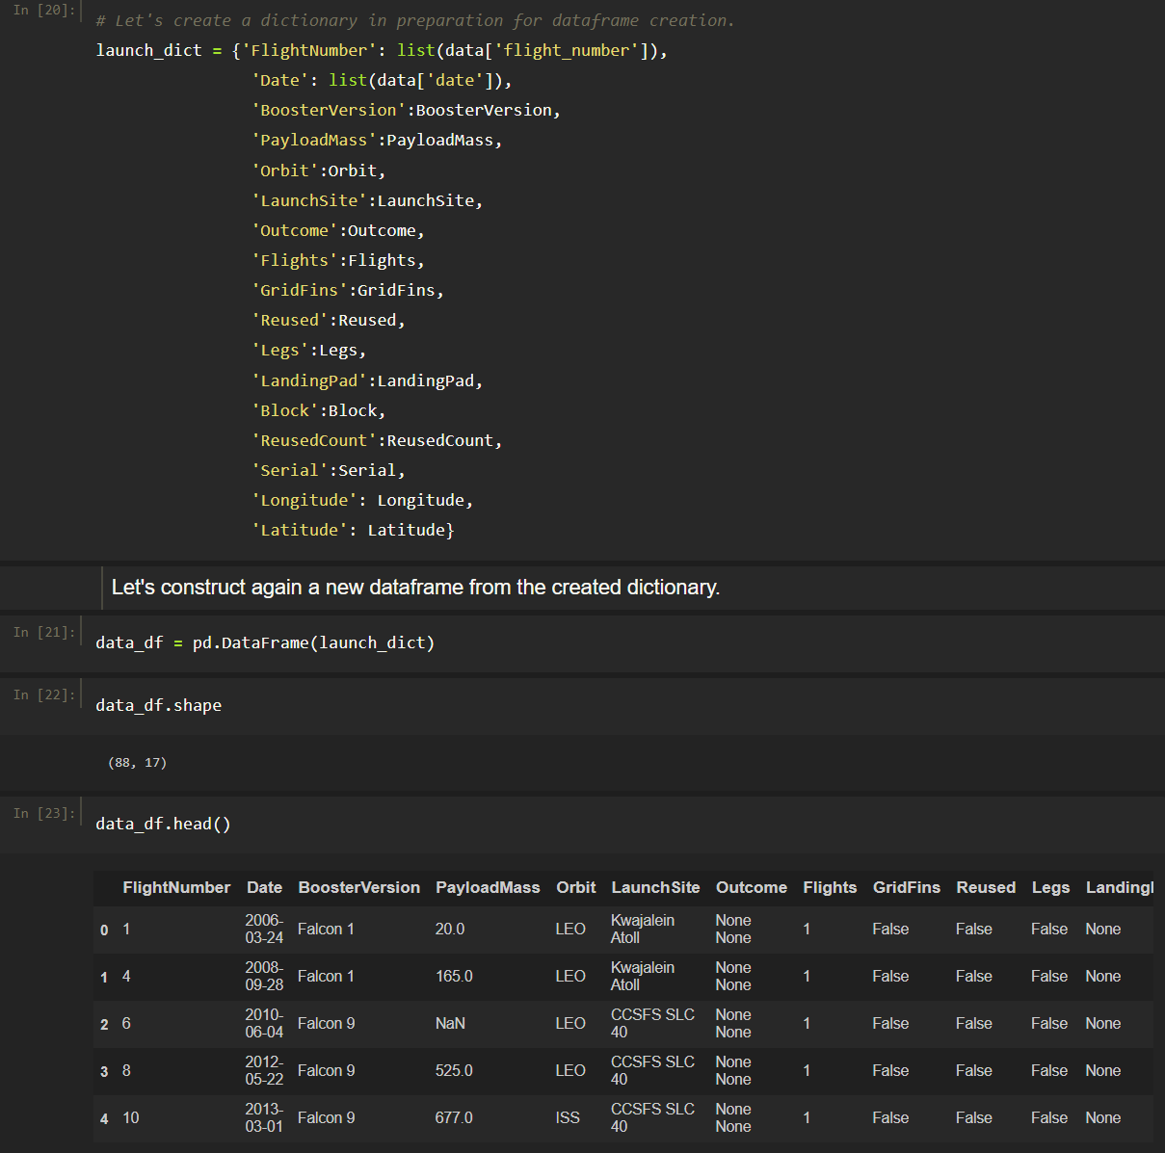
Data Collection – Scraping-3
7
8
9
Link: SpaceX Data Collection API

Slide 11
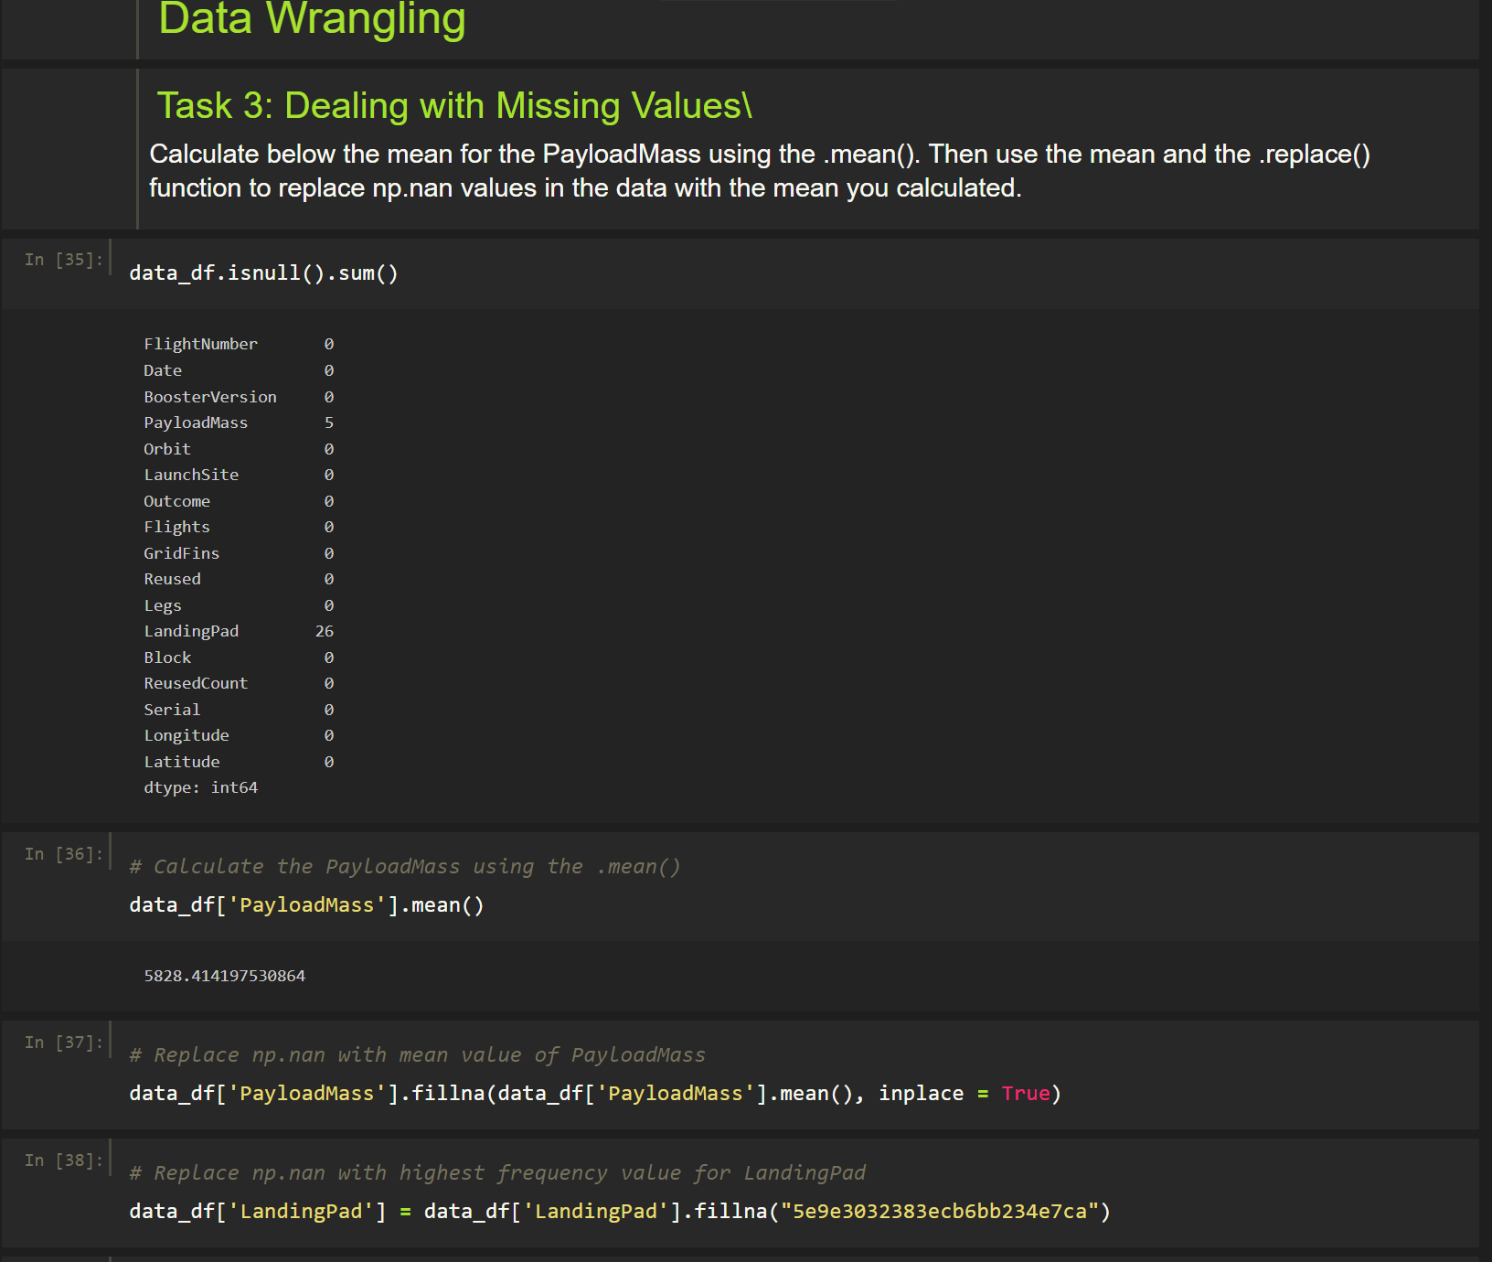
Data Wrangling
The data was processed thru an API from SpaceX URL.
Data wrangling process using key phrases and flowcharts
1. Import pandas and other libraries
2. Check missing values using .isna().sum()
3. Replace missing values .fillna() and update the object
Link: SpaceX Data Collection API

Slide 12
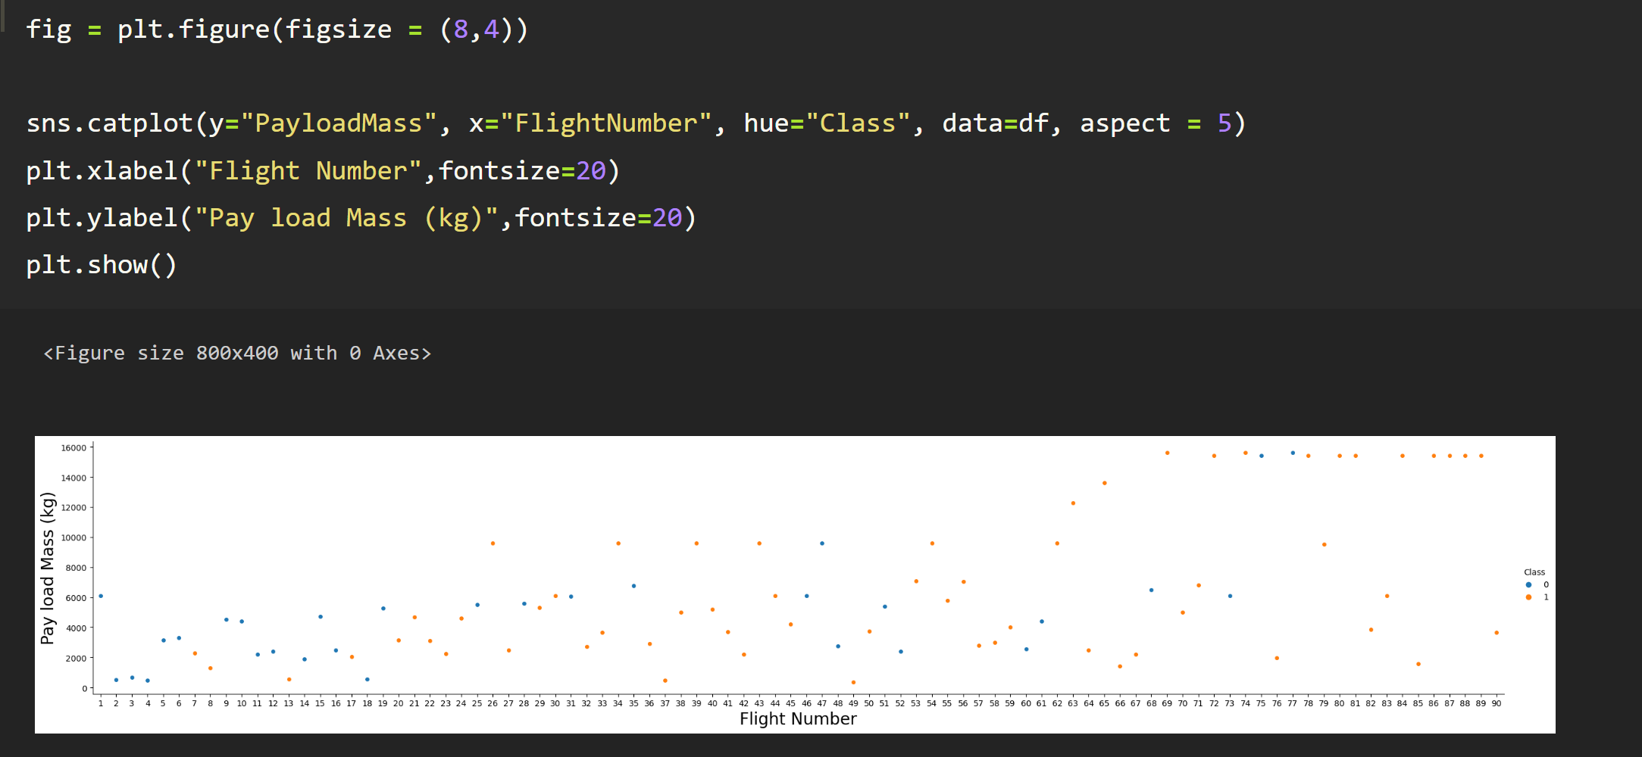
Exploratory Data Analysis Visualization-1
Chart: Scatter plot
We would like to see the relationship of FlightNumber vs PayloadMass.
Notice that as the flight number increase, the first stage is more likely to land successfully.
For payload mass, the more massive the payload, the less likely the first stage will return.
Link: Exploring_and_Preparing_Data_Viz

Slide 13
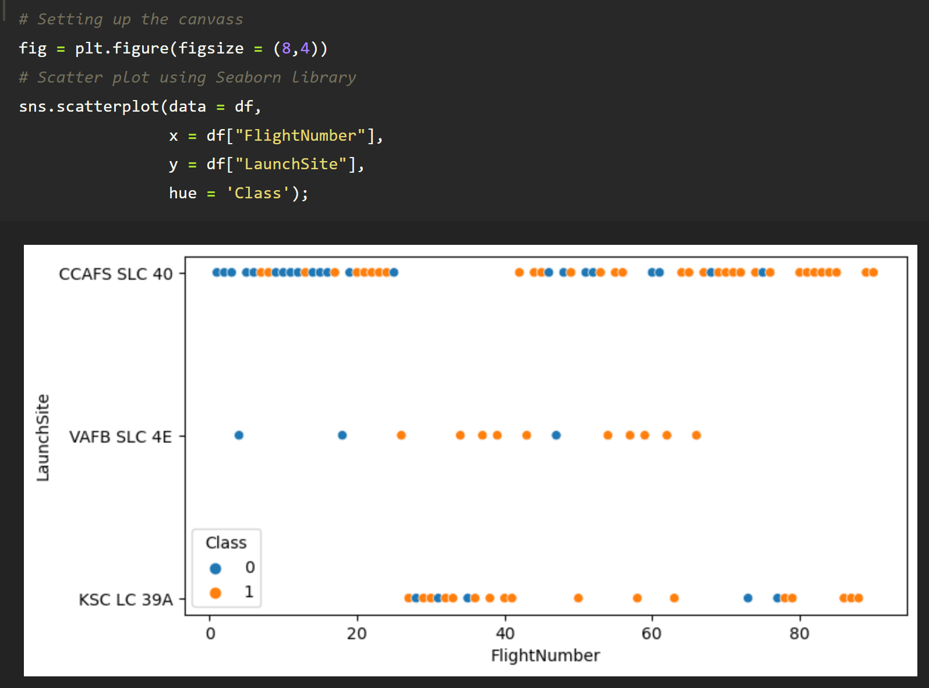
Exploratory Data Analysis Visualization-2
Chart: Scatter plot
We would like to determine the relationship of each success/fail rocket launches on respective launch sites and number of flights.
No early flights on launch site: KSC LC39A.
After 30 Flight number, the success rate increased.
CCAFS SLC 40 launch site is the frequently used.
After <50 Flight number, the rocket launches on this site discontinued.
Link: Exploring_and_Preparing_Data_Viz

Slide 14
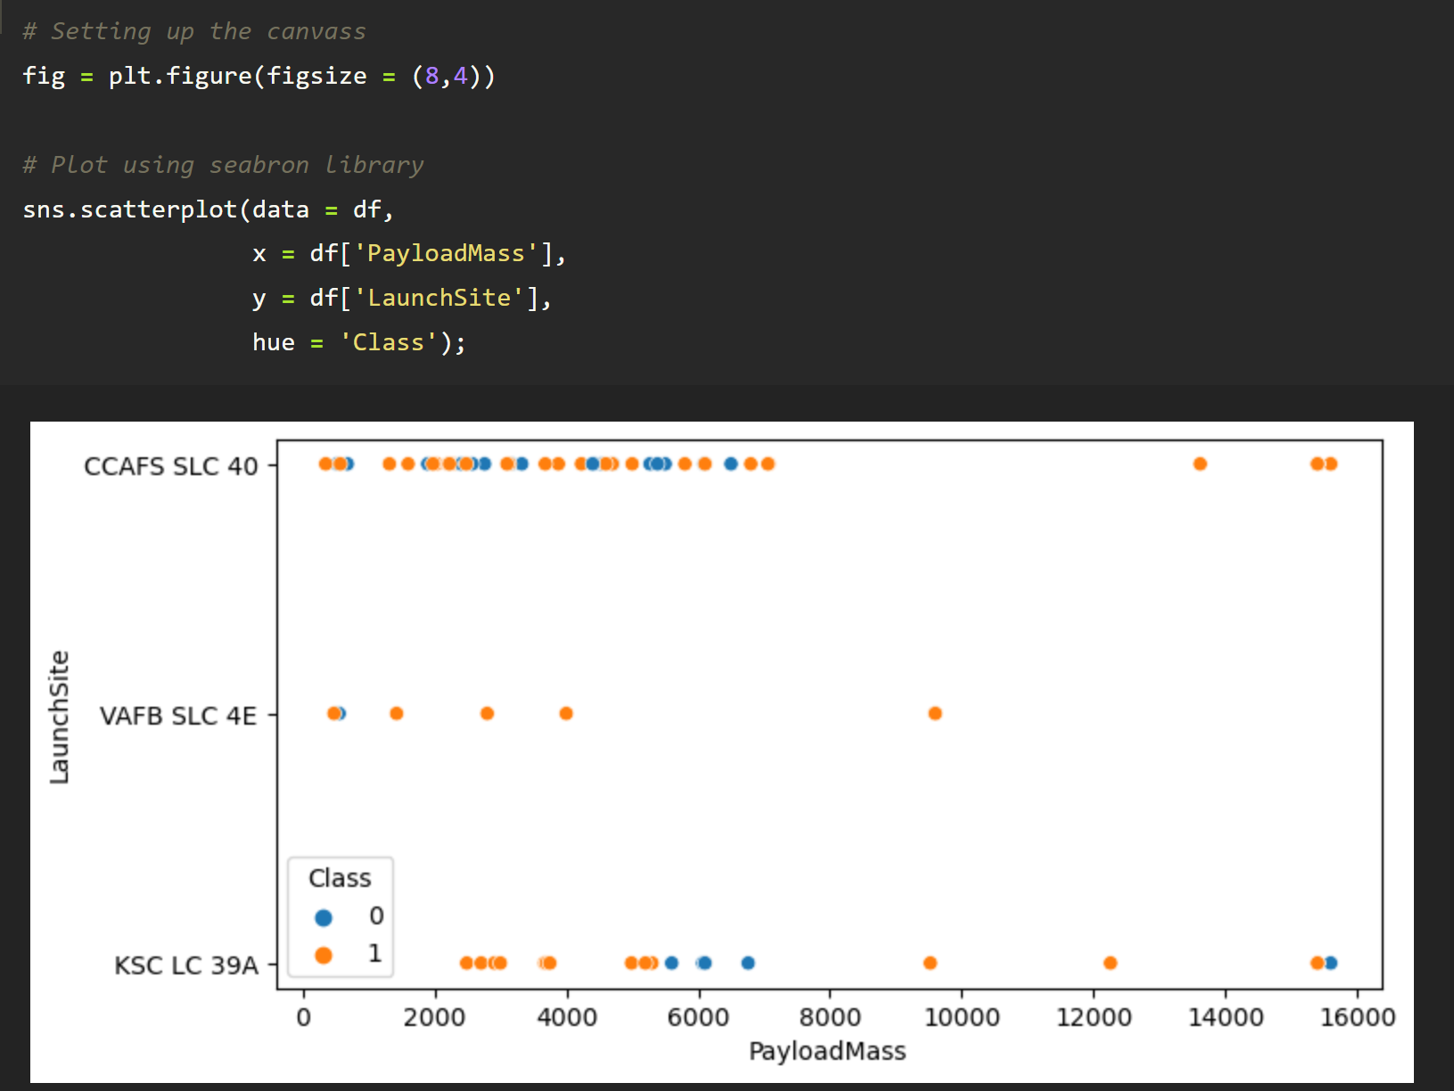
Exploratory Data Analysis Visualization-3
Chart: Scatter plot
We want to observe if there is any relationship between launch sites and their payload mass.
There are no definite correlations on all launch sites vs payloadmass based on the success/ fail rocket launches.
KSC LC 39A is the most used launch site for > 8000 payloadmass
CCAFS SLC 40 is the most used launch site for < 8000
Link: Exploring_and_Preparing_Data_Viz

Slide 15
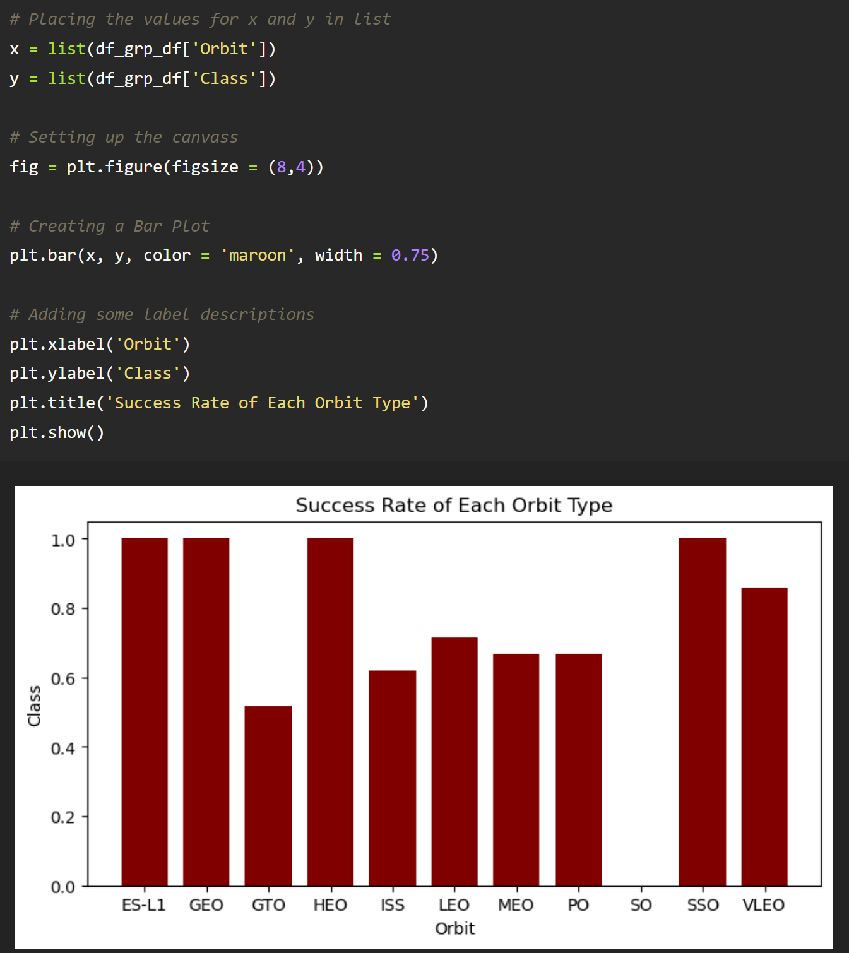
Exploratory Data Analysis Visualization-4
Chart: Bar Chart
We would like to see the success rate of each Orbit Type
Orbits ES-L1, GEO, HEO, SSO, & VLEO have success rates of > 0.8
Orbit SO has the lowest success rate
Link: Exploring_and_Preparing_Data_Viz

Slide 16
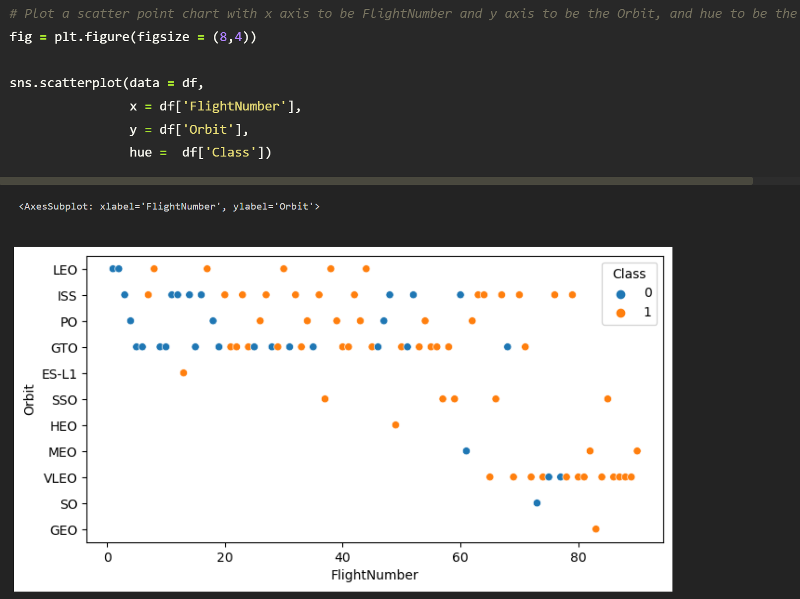
Exploratory Data Analysis Visualization-5
Chart: Scatter plot
We want to see if there is any relationship between FlightNumber and Orbit Type
Orbits LEO, ISS, GTO & PO have more failed launches on Flightnumber < 20
VLEO is the most used orbit after < 60 Flight number and secondly, ISS
ES –L1, HEO, & GEO used only once
Link: Exploring_and_Preparing_Data_Viz

Slide 17
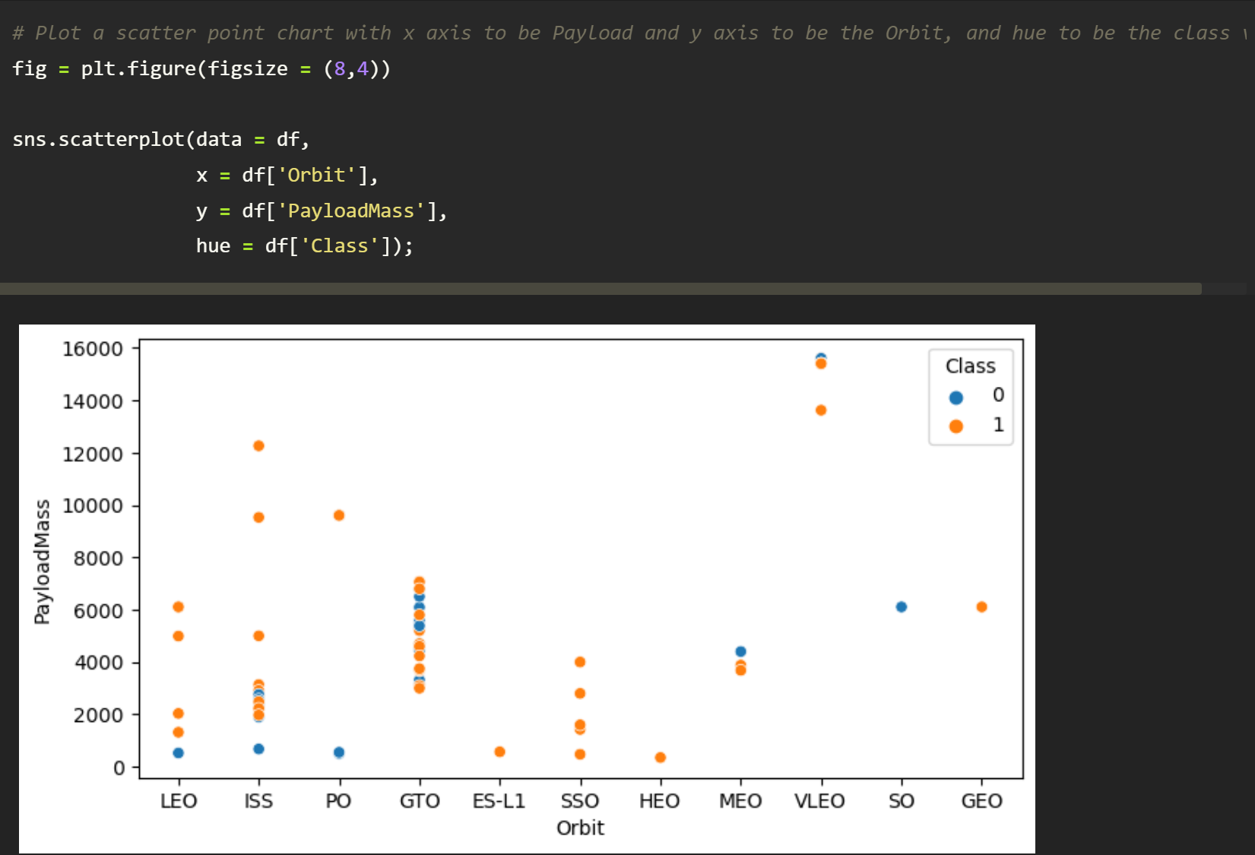
Exploratory Data Analysis Visualization-6
Chart: Scatter plot
We want to see if there is any relationship between PayloadMass and Orbit Types.
VLEO & ISS were used orbits for > 10K PayloadMass
GTO is the most used orbit for payloadmass < 8K
Link: Exploring_and_Preparing_Data_Viz

Slide 18
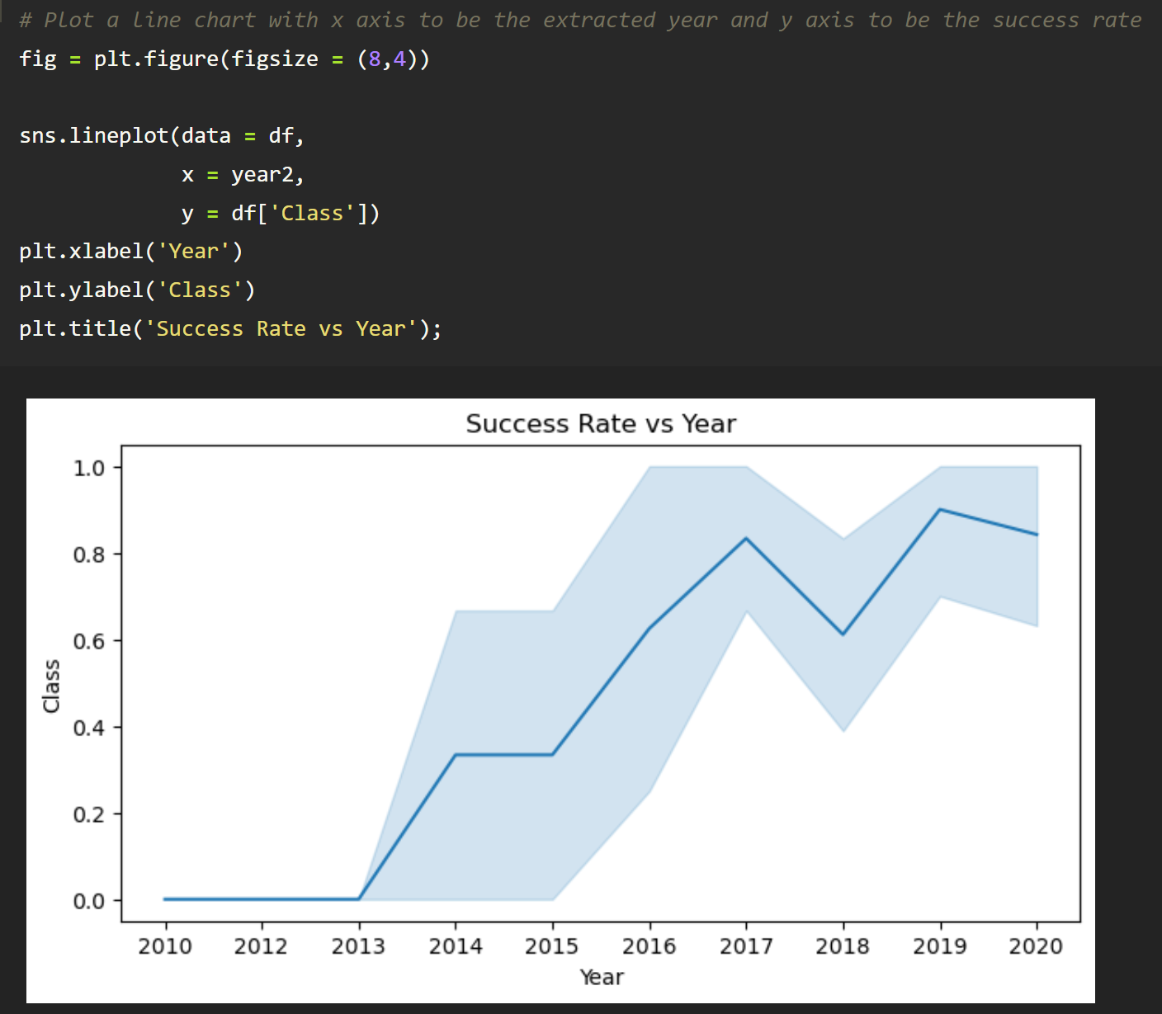
Exploratory Data Analysis Visualization-7
Chart: Line Graph
Why: We want to see if there are some patterns or trends on Success rate vs Year
For 2015 yr onwards, there was a drastically increase on success rate (0.4 - 0.8) until 2017 yr
2019- 2020 yr the success rate is maintained between 0.8 to 1. This is good a performance.
Link: Exploring_and_Preparing_Data_Viz

Slide 19
EDA with SQL-1
SQL queries that has been performed to get desired data
Explore data from the database/ dataset.
%sql select * from SPACEXDATASET
Pick unique values on landing_outcome column.
%sql select DISTINCT landing__outcome from SPACEXDATASET
Display names of the unique launch sites in the space mission.
%sql select DISTINCT LAUNCH_SITE from SPACEXDATASET
Display 5 records where launch sites begin with the string ‘CCA’
%sql select * from SPACEXDATASET where launch_site like 'CCA%' limit 5
Display the total payload mass carried by boosters launched by NASA (CRS).
%sql select sum(payload_mass__kg_) as sum from SPACEXDATASET where customer like 'NASA (CRS)'
Display average payload mass carried by booster version F9 v1.1.
%sql select avg(payload_mass__kg_) as Average from SPACEXDATASET where booster_version like 'F9 v1.1%'
List the date when the first successful landing outcome in ground pad was achieved.
%sql select min(date) as Date from SPACEXDATASET where mission_outcome like 'Success'
List the names of the boosters which have success in drone ship and have payload mass greater than 4000 but less than 6000
%sql select booster_version from SPACEXDATASET where (mission_outcome like 'Success')
&& (payload_mass__kg_ BETWEEN 4000 AND 6000) AND (landing__outcome like 'Success (drone ship)')
Link: Exploration_Data_Analysis

Slide 20
EDA with SQL -2
SQL queries that has been performed to get desired data
List the total number of successful and failure mission outcomes.
%sql SELECT mission_outcome, count(*) as Count FROM SPACEXDATASET GROUP by mission_outcome ORDER BY mission_outcome
List the names of the booster_versions which have carried the maximum payload mass . Use a subquery.
maxm = %sql select max(payload_mass__kg_) from SPACEXDATASET
maxv = maxm[0][0]
%sql select booster_version from SPACEXDATASET where
payload_mass__kg_=(select max(payload_mass__kg_) from SPACEXDATASET)
List the records which will display the month names, failure landing_outcomes in drone ship, booster versions, launch_site for the months in year 2015.
%sql select MONTHNAME(DATE) as Month, landing__outcome, booster_version, launch_site
from SPACEXDATASET where DATE like '2015%' AND landing__outcome like 'Failure (drone ship)'
Rank the count of successful landing_outcomes between the data 2010-06-04 and 2017-03-20 in descending order.
%sql select landing__outcome, count(*) as count from SPACEXDATASET
where Date >= '2010-06-04' AND Date <= '2017-03-20’
GROUP by landing__outcome ORDER BY count Desc
Link: Exploration_Data_Analysis

Slide 21
Build an Interactive Map with Folium
Summarize what map objects such as markers, circles, lines, etc. you created and added to a folium map
I've added respective marker coordinates for each launch sites, rocket color indicators for success & fail, and some distance calculations for nearest rail ways, highways, coastline, & cities.
Explain why you added those objects
I’ve added these marks and labels to define properly each respective locations on map. This kind of method also helps us to give insights for further study and reference.
Link: Launch_Sites_Location Analysis-with_Folium

Slide 22
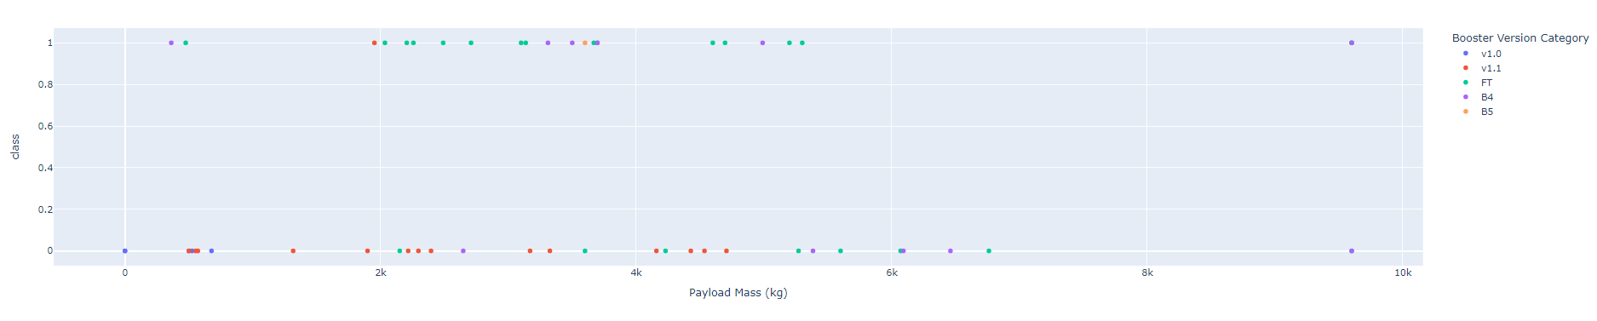
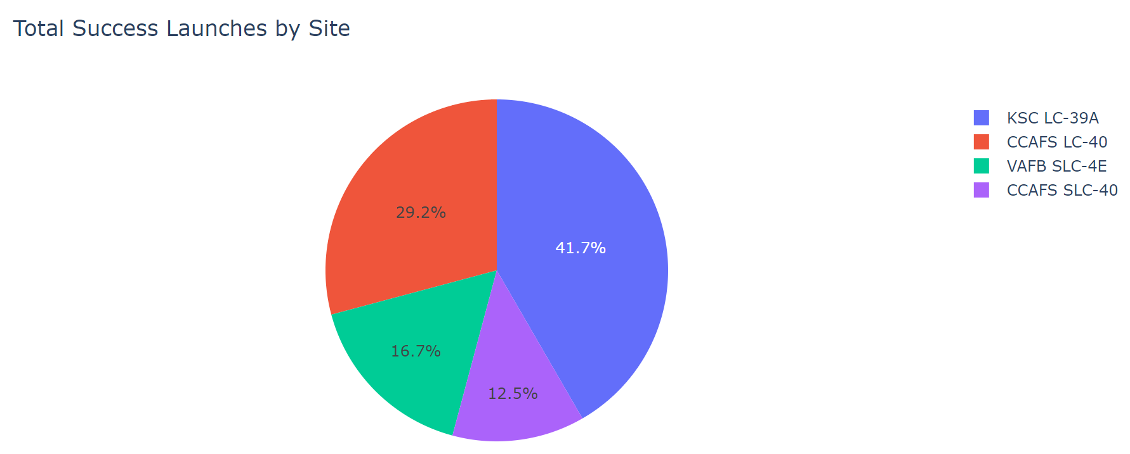
Build a Dashboard with Plotly Dash
Scatter Plot Pie Chart
An initial visual overview of SpaceX Data
Using the link indicated we can open the .ipy notebook, run the script and interact with the dashboard.
Link: SpaceX_Dashboard

Slide 23
Predictive Analysis (Classification) - 1
Summarized Method
Getting the Data ready
Check the data types
Check for missing values
Split the data into train and test data set
Chose the right estimator or model
Fit the data into the model
Evaluate the model
Improve the model
Save the trained model
Note: Having the highest evaluation metrics will be considered a good performing classification model.
Link: SpaceX_Machine_Learning

Slide 24
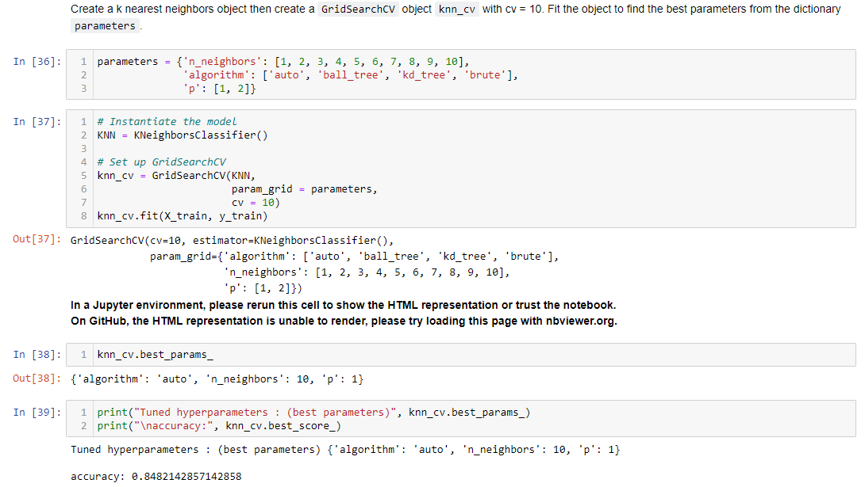
Predictive Analysis (Classification) - 2
Present the model development process using key phrases and flowchart
After the model has been trained and evaluated, we used GridSearchCV to search for the best parameter on the selected models and evaluate its score on the test label data. We will take the model with the best score.
Set parameters (these values are given)
Instantiate the model, use GridSearchCV and train the model
Get best parameter and best score
Link: SpaceX_Machine_Learning

Slide 25
Predictive Analysis (Classification) - 3
These values are given
Select a model, use GridSearchCV and train the model
Get the best score & parameter of the model
Link: SpaceX_Machine_Learning

Slide 26
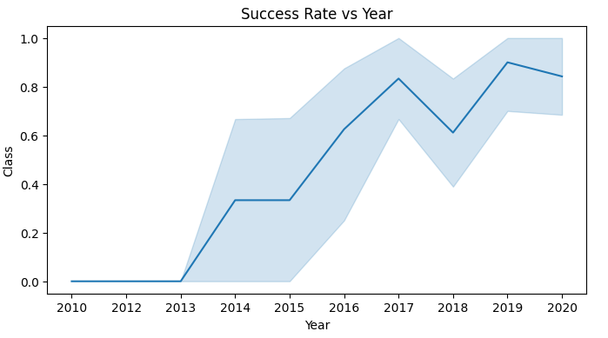
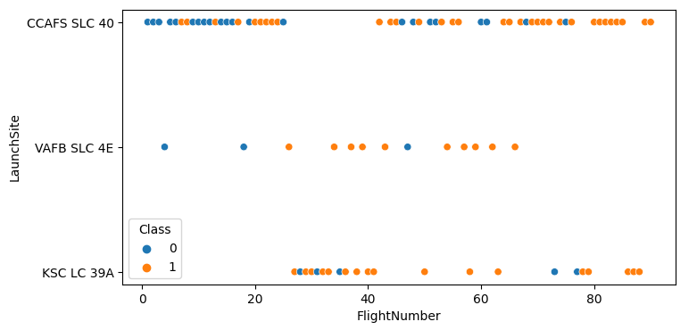
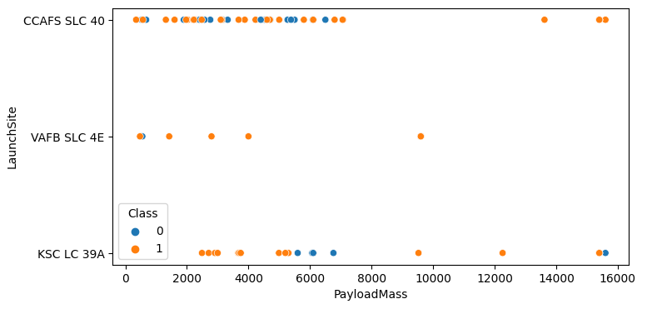
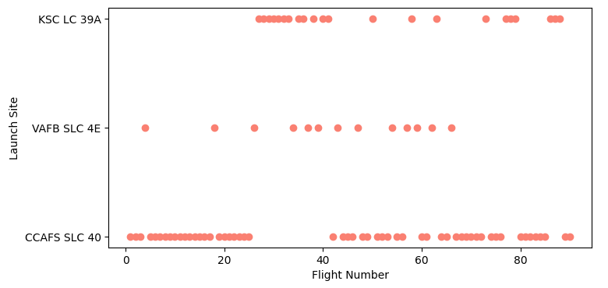
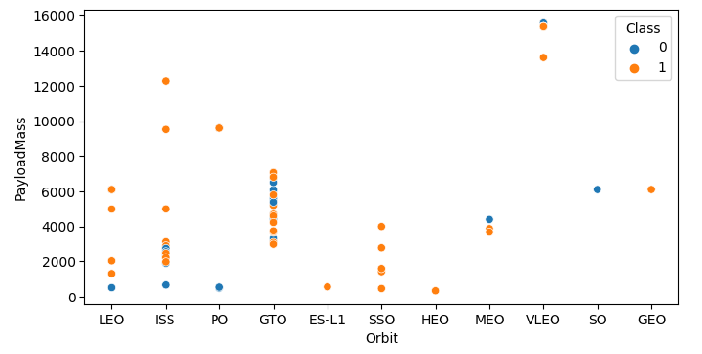
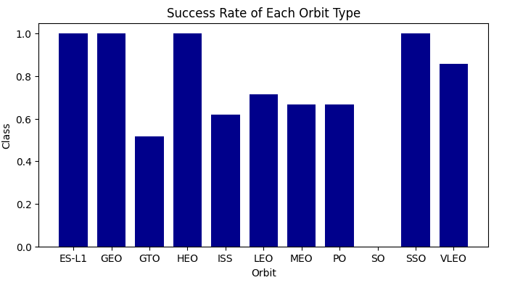
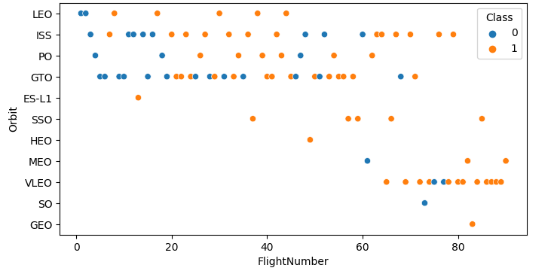
Results – Exploratory Data Analysis Results

Slide 27
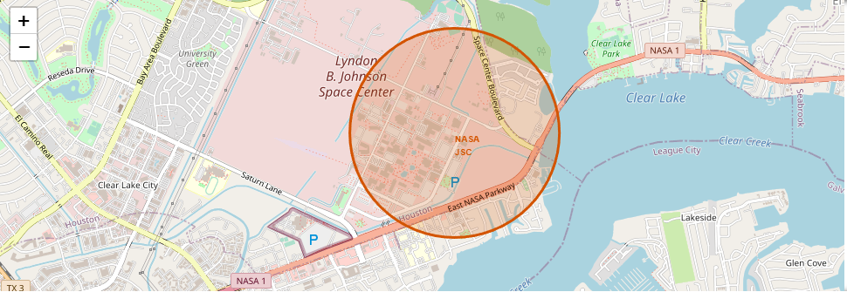
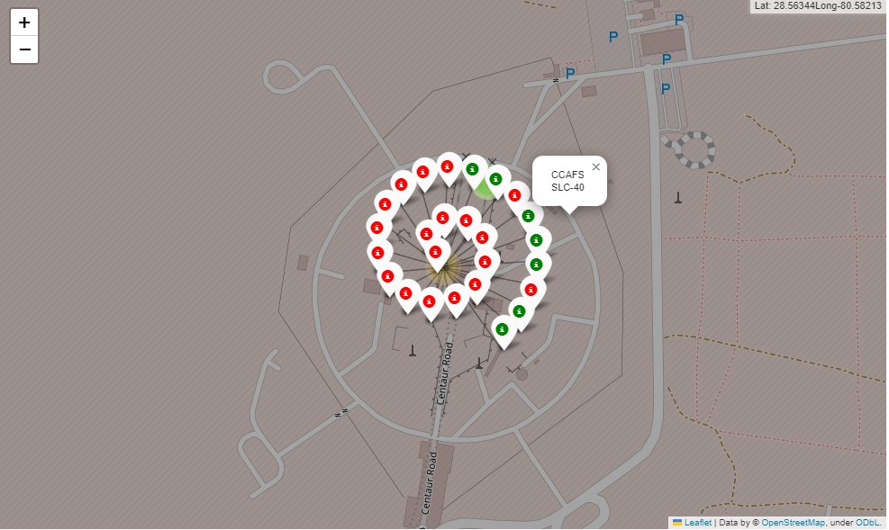
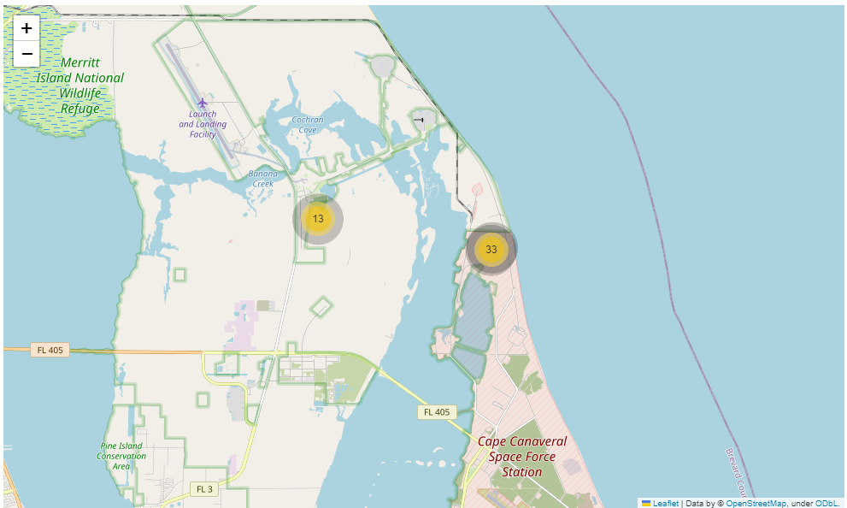
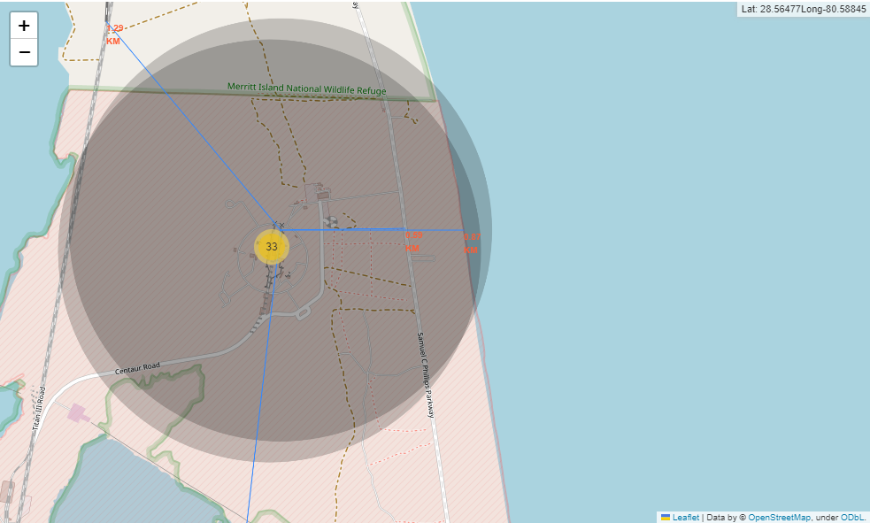
Results – Interactive Analytics Demo in Screenshots

Slide 28
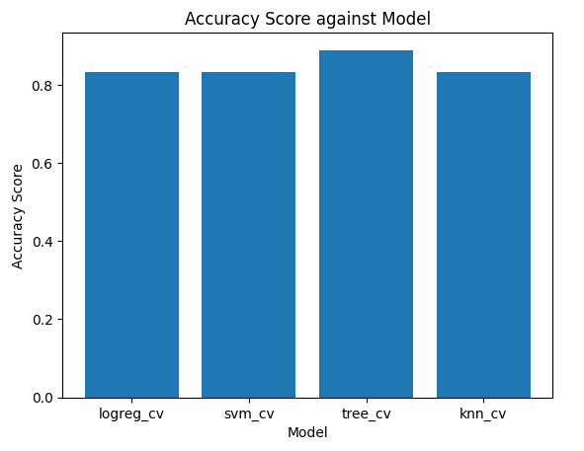
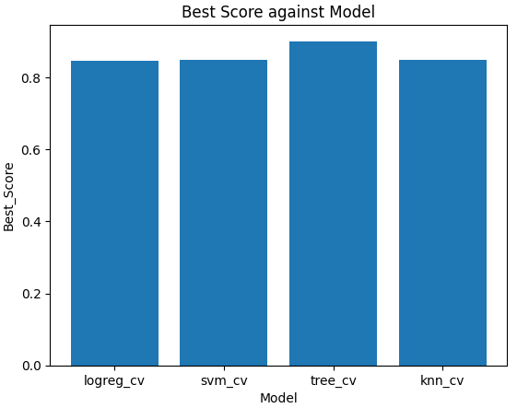
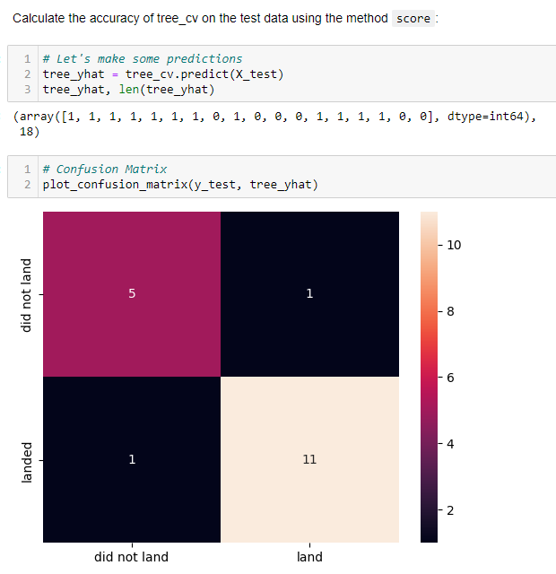
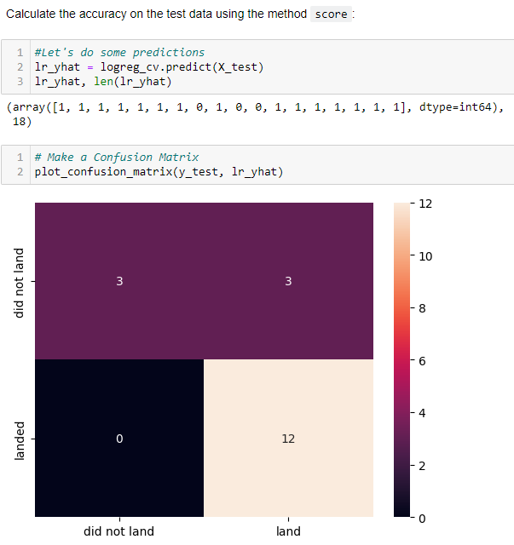
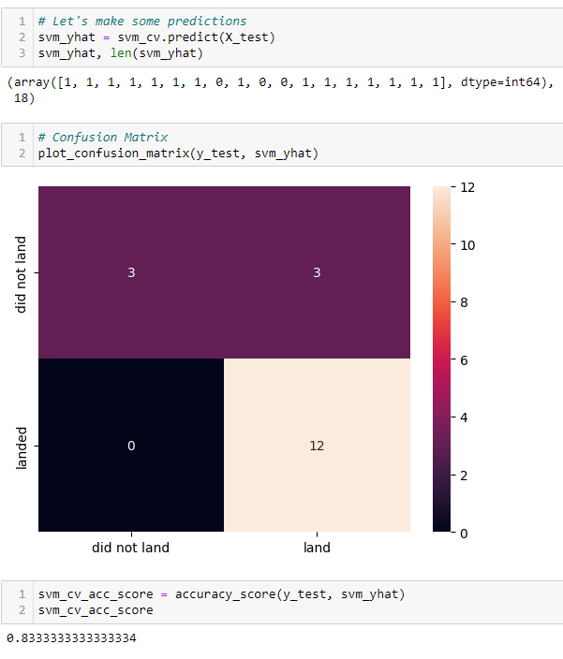
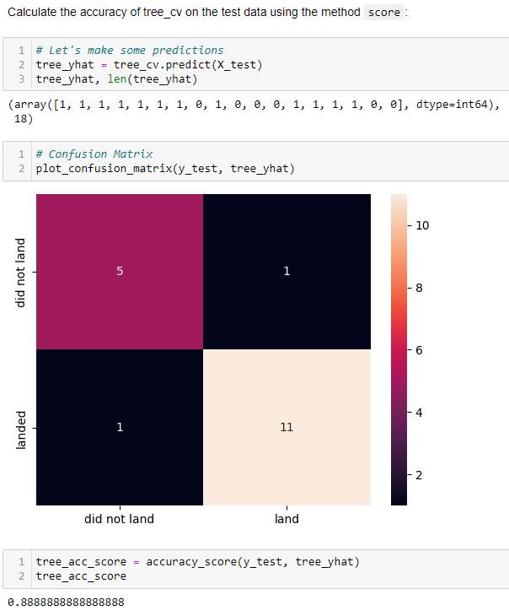
Results – Predictive Analysis Results

Slide 29

Section 2

Slide 30
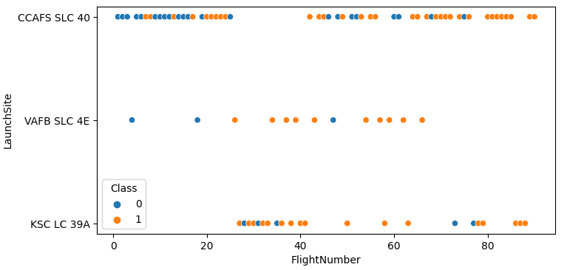
Flight Number vs. Launch Site
Scatter plot of Flight Number vs. Launch Site
We can see the behaviors of each Launch Sites based on the Flight Number.
KSC LC 39A used in Flightnumber between 25 – 40.
VAFB SLC 4E not used frequently but the success rate is good.
CCAFS SLC 40 used frequently on Flightnumber < 25 and > 40.
Link: Exploring_and_Preparing_Data_Viz

Slide 31
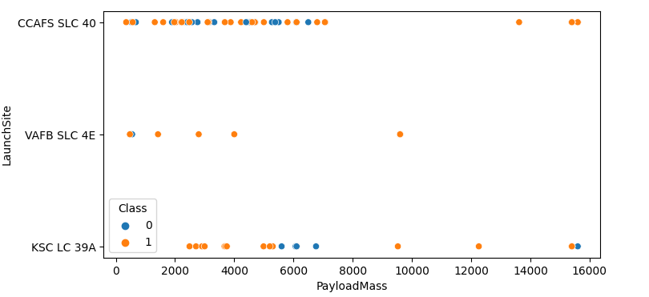
Payload vs. Launch Site
Scatter plot of Payload vs. Launch Site
We can see that the LaunchSite VAFB SLC 4E has no rocket launched with 10K PayloadMass and KSC LC 39A is an alternative launch site area for CCAFS SLC 40 for PayloadMass 8K.
Link: Exploring_and_Preparing_Data_Viz

Slide 32
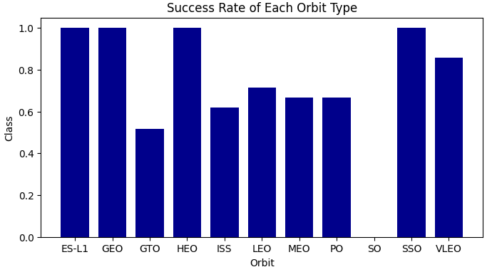
Success Rate vs. Orbit Type
Bar chart for the success rate of each orbit type
Orbits that has a 100% success rates are the following:
Sun-synchronous Orbit (SSO)
Earth-Sun First Lagrangian Point (ES-L1)
Geostationary Orbit (GEO)
High Earth Orbit (HEO)
Link: Exploring_and_Preparing_Data_Viz

Slide 33
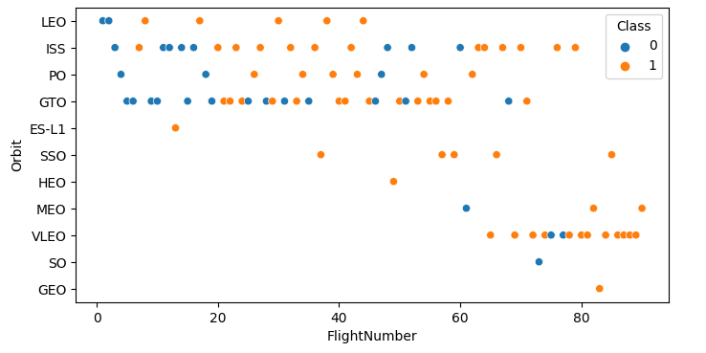
Flight Number vs. Orbit Type
Scatter point of Flight number vs. Orbit type
As we can see, the number of flight increases the success rate of rocket launches also increases.
Link: Exploring_and_Preparing_Data_Viz

Slide 34
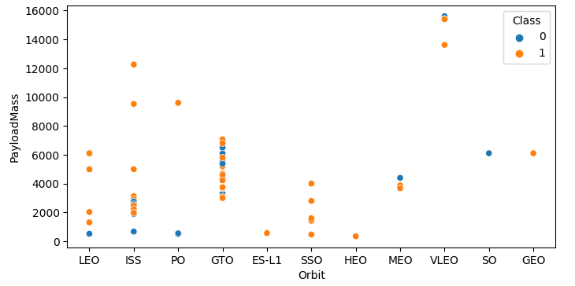
Payload vs. Orbit Type
Scatter point of payload vs. orbit type
We can notice the following that each orbits has respective PayloadMass that maintain.
GTO PayloadMass ranges 2K to 8K
ISS, LEO, SSO, MEO, SO & GEO PayloadMasses range 0 to 6K
VLEO PayloadMass range to 12K and up
Link: Exploring_and_Preparing_Data_Viz

Slide 35
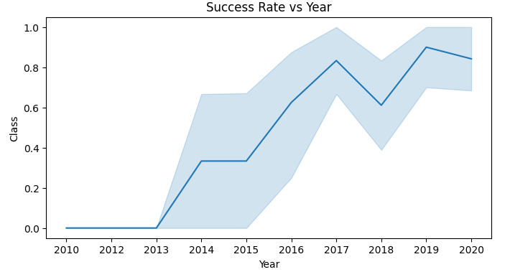
Launch Success Yearly Trend
Line chart of yearly average success rate
We can see a gradual increase of the success rate year 2013 onwards till 2020.
Link: Exploring_and_Preparing_Data_Viz

Slide 36
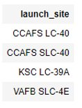
All Launch Site Names
Query unique launch sites
Result
Using DISTINCT function in SQL returns unique values
Link: Exploration_Data_Analysis

Slide 37
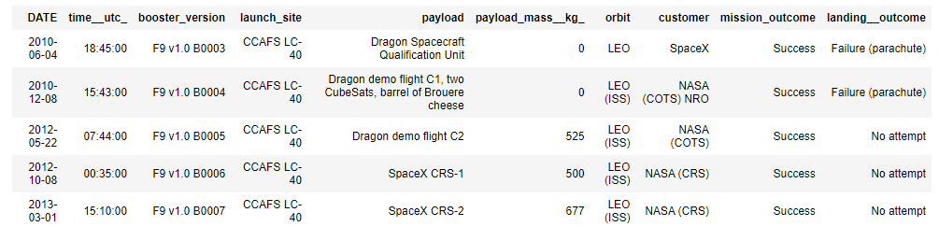
Launch Site Names Begin with 'CCA'
Query 5 records where launch sites begin with `CCA`
Result
Using limit function, it returns the first 5 rows of the table.
Link: Exploration_Data_Analysis

Slide 38
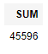
Total Payload Mass
Query the total payload carried by boosters from NASA
Result
Return the sum of column 'payload_mass_kg' from SPACEXDATASET which has 'NASA (CRS)' values.
Link: Exploration_Data_Analysis

Slide 39
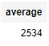
Average Payload Mass by F9 v1.1
Query average payload mass carried by booster version F9 v1.1
Result
Using SELECT AVG(payload_mass_kg_) function will get the average of the values in payload_mass_kg_.
Using WHERE will filter the dataset and LIKE will find the similar or closest wildcard or character that is present.
Link: Exploration_Data_Analysis

Slide 40
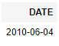
First Successful Ground Landing Date
Query the dates of the first successful landing outcome on ground pad
Result
Returns the minimum date from Date column of SPACEXDATASET that has been filtered on success only.
Link: Exploration_Data_Analysis

Slide 41
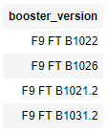
Successful Drone Ship Landing with Payload between 4000 and 6000
Query the names of boosters which have successfully landed on drone ship and had payload mass greater than 4000 but less than 6000
Result
Using a nested query, nested means a query inside of a query. This is use for filtering or excluding some data that has been filtered or excluded already.
Link: Exploration_Data_Analysis

Slide 42
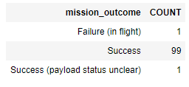
Total Number of Successful and Failure Mission Outcomes
Query the total number of successful and failure mission outcomes
Result your query result with a short explanation here
Returns the count of mission_outcome and was grouped by mission_outcome values.
We also use order by function to display in alphabetical order.
Link: Exploration_Data_Analysis

Slide 43
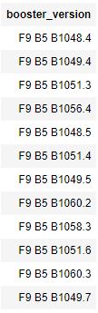
Boosters Carried Maximum Payload
Query the names of the booster which have carried the maximum payload mass
Result
Return the values of booster_version from the dataset SPACEXDATASET which has the maximum payload_mass_kg_ value only.
Link: Exploration_Data_Analysis

Slide 44
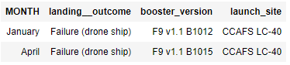
2015 Launch Records
Query the failed landing_outcomes in drone ship, their booster versions, and launch site names for in year 2015
Result
Return the data such as date month, landing outcome, booster version and launch site which have a '2015' and 'Failure (drone ship)' values.
Link: Exploration_Data_Analysis

Slide 45
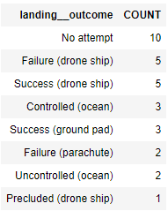
Rank Landing Outcomes Between 2010-06-04 and 2017-03-20
Query the count of landing outcomes (such as Failure (drone ship) or Success (ground pad)) between the date 2010-06-04 and 2017-03-20, in descending order
Result
Return the landing_outcome and count of landing_outcome values from the SPACEXDATASET between dates 2010-06-04 to 2017-03-20
Link: Exploration_Data_Analysis

Slide 46

Section 3

Slide 47



Launch Sites Locations
All SpaceX Launch Sites locations are on coast of United States of America.
Link: Launch_Sites_location_Analysis_with_Folium

Slide 48





Success/ Failed Launches for each Launch Sites
Launches are grouped into clusters and annotated with green- successful rocket launch and red-unsuccessful colors respectively.
Link: Launch_Sites_location_Analysis_with_Folium

Slide 49


Other Points of Interest from Launch Sites Proximity
The Launch Site - CCAFS SCL 40 as example. We can identify:
Nearest Coastline is 0.87 KM due East
Nearest Highway is 0.59 KM away
Nearest Railway is 1.29 KM away
Nearest City is 51.74 KM away
Link: Launch_Sites_location_Analysis_with_Folium

Slide 50

Section 4

Slide 51





Total Success Launches by Site
Summary of Total Rocket Launches per Site and their success rates
Link: Interactive_Visual_Analytics_and_Dashboard

Slide 52

Launch Site: KSC LC-39A
The launch site with highest launch success/ failure ratio
Link: Interactive_Visual_Analytics_and_Dashboard

Slide 53

Payload vs Launch Outcome Scatter Plot
This is a scatter plot for all sites, with different payload selected in the range slider
We can notice a correlation between class and Payload Mass (KG):
0 – 4000 Kg (low payload)
4000 – 10000 Kg (high payload)
Based on these 2 scales, we can say that the success rate for high payload is lower than the low payload.
Link: Interactive_Visual_Analytics_and_Dashboard

Slide 54

Section 5

Slide 55

Classification Accuracy
Built model accuracy for all built classification models (Bar Chart)
Link: SpaceX_Machine_Learning

Slide 56

Confusion Matrix of the Best Performing Model
The confusion matrix of the best performing model has a low rate of error based on test label and prediction label. As we can see, there is only 1 count or value that has been assigned for false negative and false positive.
Note:
False negative = landed & did not land
False positive = land & did not land
Link: SpaceX_Machine_Learning

Slide 57



Conclusions
The best Classification Model is Decision Tree with accuracy score of {}.
The higher chance of success rate should have the maximum 4000 kg payload mass.
The Launch Site KSC LC-39A has the highest success/fail rocket launch ratio.
Orbit types such as GEO, HEO, SSO, and ES-L1 have the 100% success rate.
We can use the characteristic parameter of these for performance capability.
Link: SpaceX_Machine_Learning

Slide 58


